Slide 1
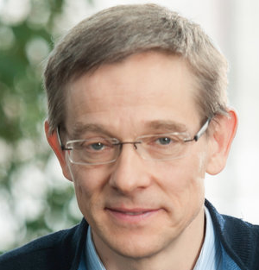
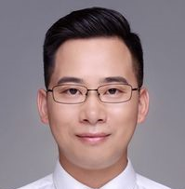
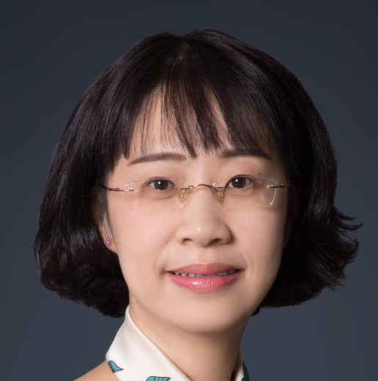
About Me – Yong Guo (国雍)
Education & Research Experiences (Google Scholar Citation 1300+)
Max Planck Institute for Informatics Saarbrücken, Germany
Postdoc in the group of CVML 2021 - Now
Supervisor:
Prof. Bernt Schiele (IEEE Fellow, ACM Fellow)
South China University of Technology Guangzhou, China
Ph.D. in Software Engineering 2016 - 2021
Supervisor:
Prof. Mingkui Tan (谭明奎)
Prof. Jian Chen (陈健)
Intern Experience
Tencent AI Lab Shenzhen, China
Intern in Machine Learning Group 2018 - 2021
1

Slide 2








Publications & Awards
Publications (20+ papers, including 16 first-author papers)
10 conference papers published in CVPR, NeurIPS, ICML, ECCV, AAAI, etc.
12 journal papers published in TPAMI, TMM, Neural Networks, etc.
Awards & Honors
MSRA Fellowship Nomination Award (Top 20 Ph.D. candidates in Asia, 2018)
National Scholarship (2019年和2020年两次获得国家奖学金)
Oral presentations in top-tier conferences (ECCV, ICML, AAAI)
Patents (5项发明专利)
3项模型压缩相关的发明专利
2项高效训练算法相关的发明专利
Collaborations
Academia
Industry
2

Slide 3
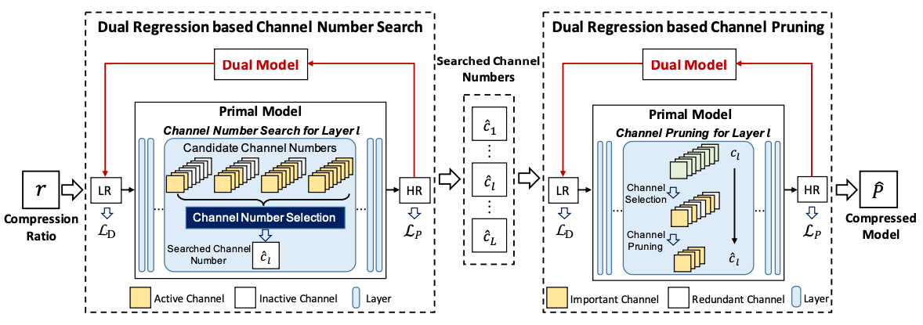
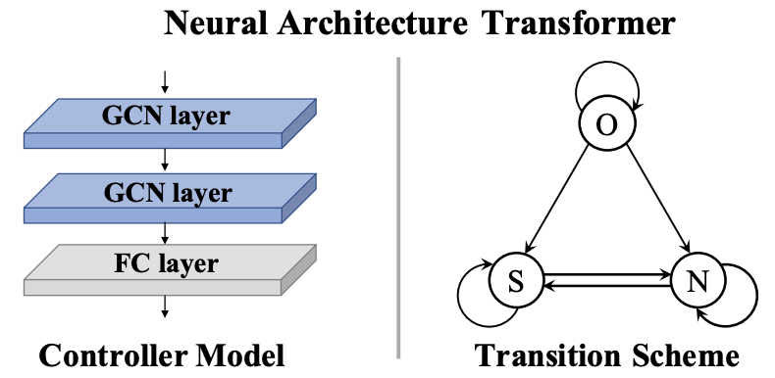
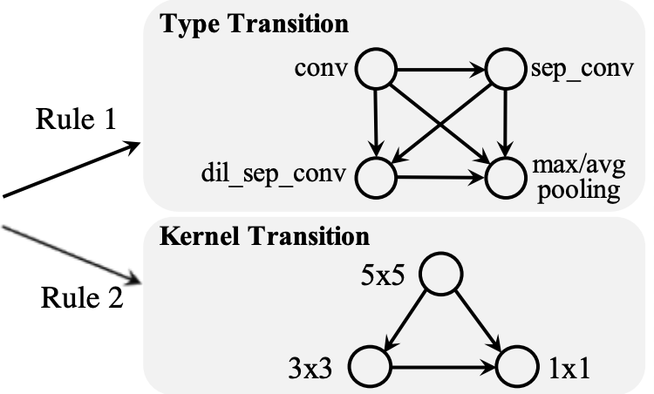
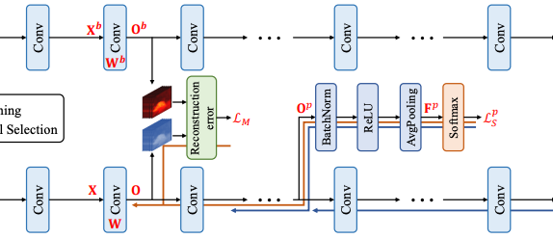
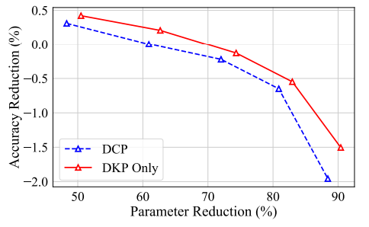
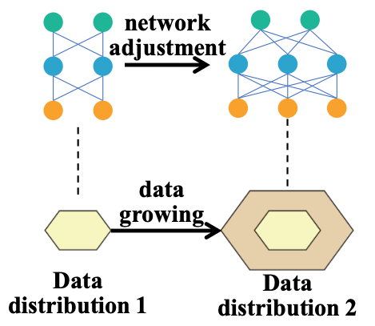
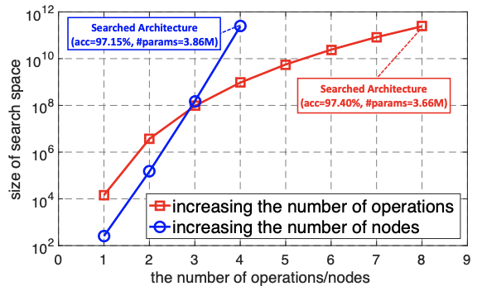
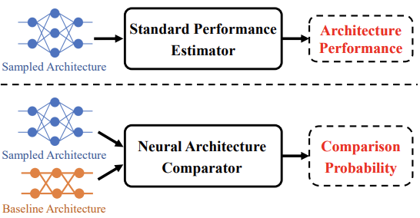
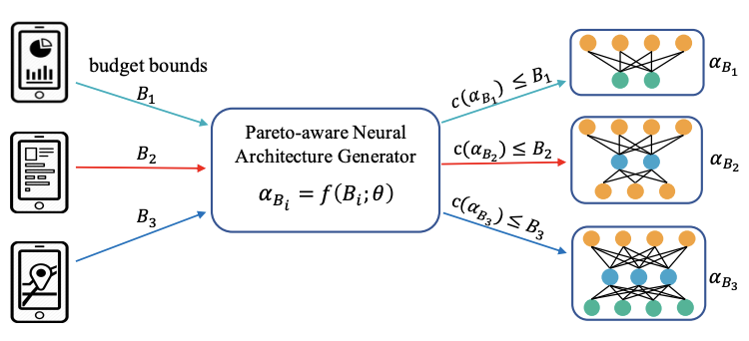
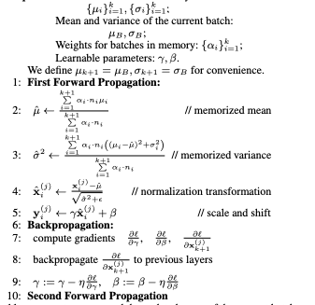
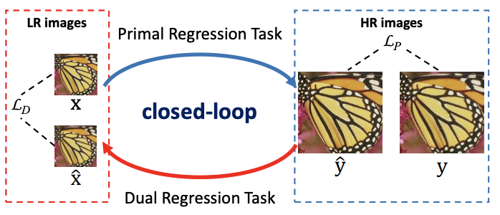
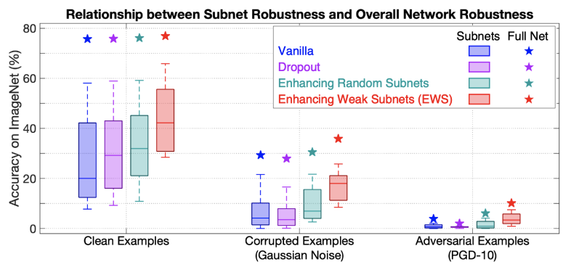
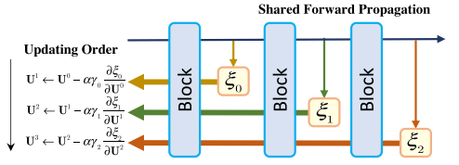
Research Interests and Contributions
Research Interests
I specifically focus on developing accurate and compact deep networks.
Model/Architecture Compression
Neural Architecture Transformer
NeurIPS’19
TPAMI’21
TPAMI (under review)
NeurIPS’18
TPAMI’21
Compact Architecture Design (Neural Architecture Search)
ICML’20
CVPR’21
TPAMI (under review)
ICML’21
Effective Training Method
CVPR’19
ECCV’22
AAAI’18
NN’21
3

Slide 4
Towards Accurate and Compact Deep Neural Networks
Yong Guo
Max Planck Institute for Informatics
4

Slide 5
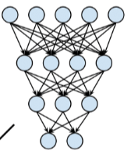

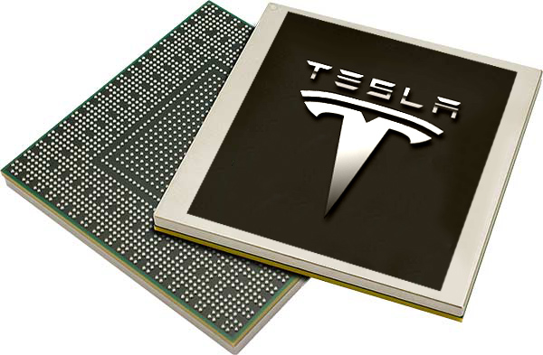

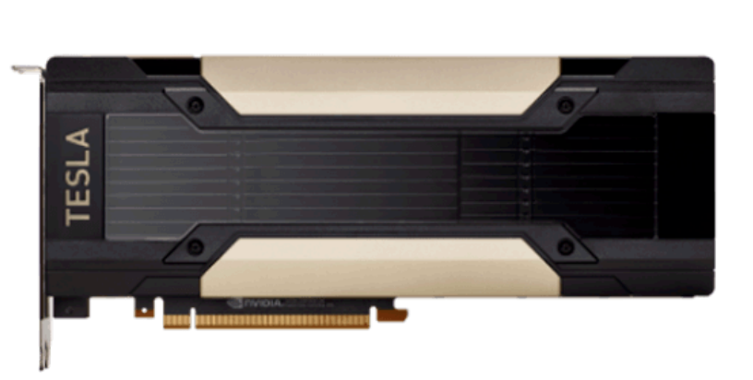

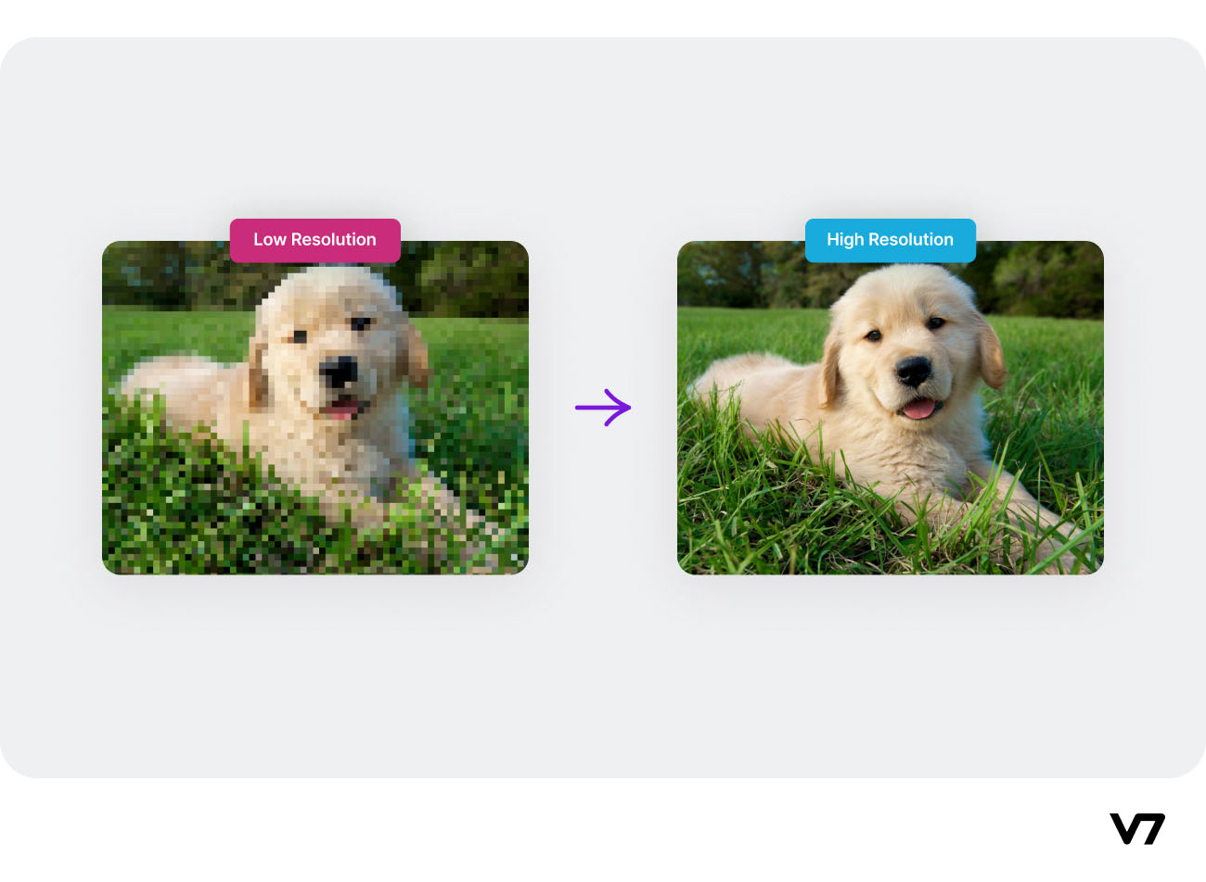
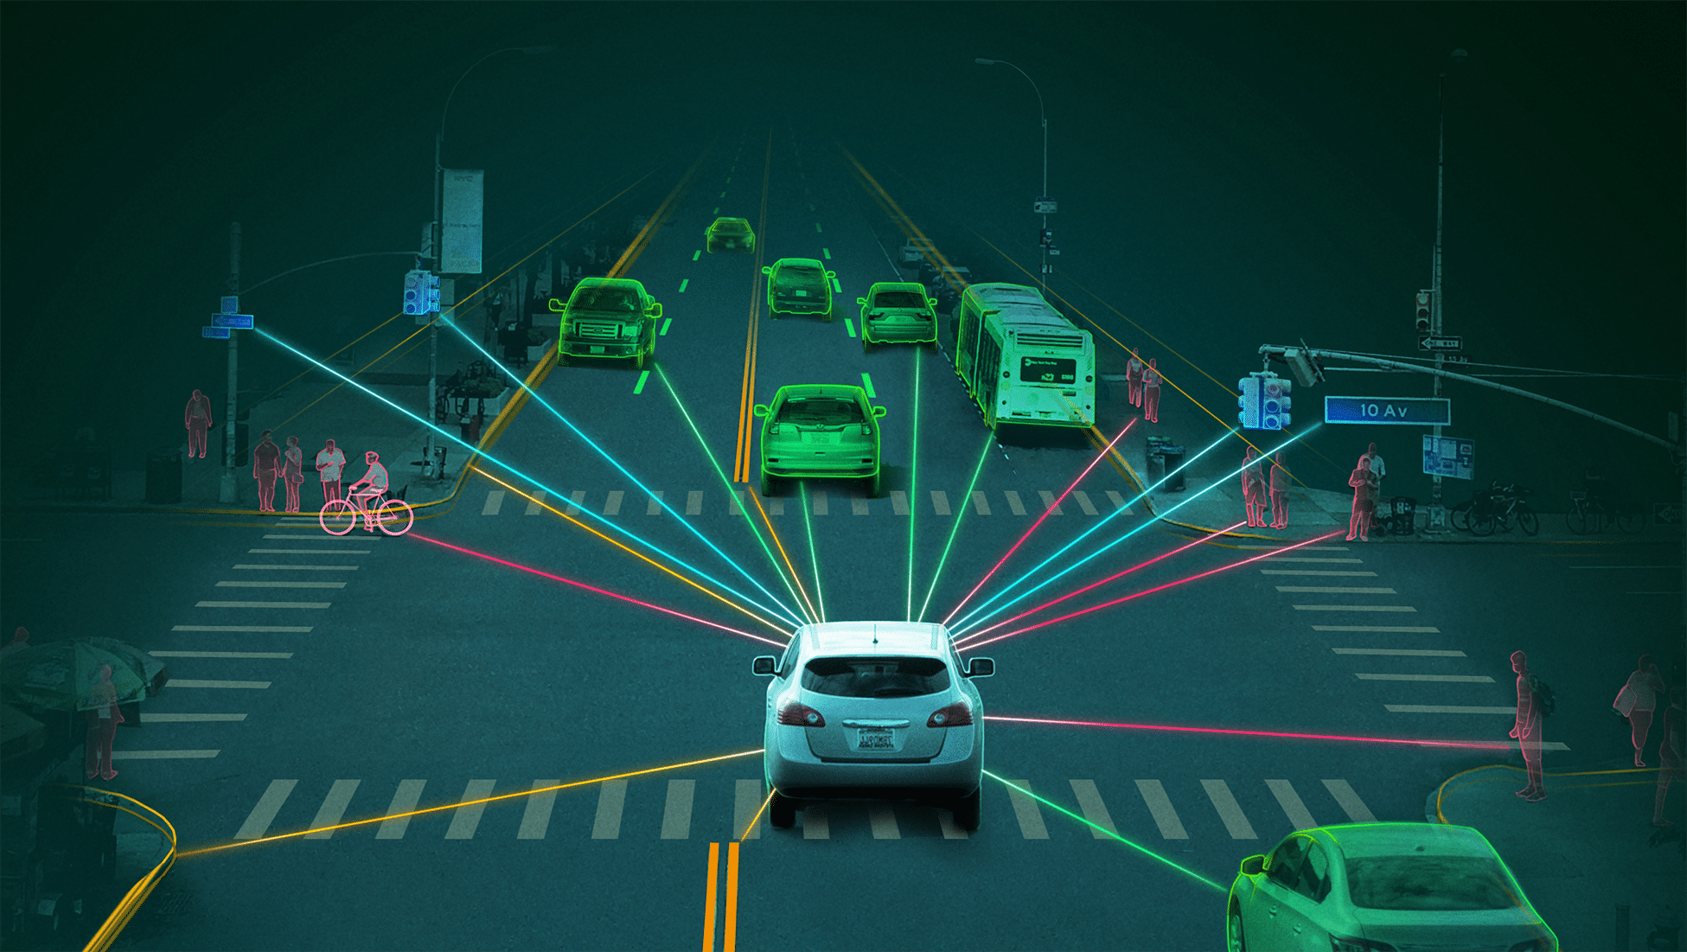
Compactness is Important in Real-world
Models should be accurate and very compact for deployment
Real-world Requirements:
Inference with low latency
Edge Devices
(with Limited Computational Resources)
Deployment
Limitations of using cloud:
Without internet connectivity
Privacy perserving
Real-time Translation
Image Super-Resolution
Autonomous Driving
5

Slide 6
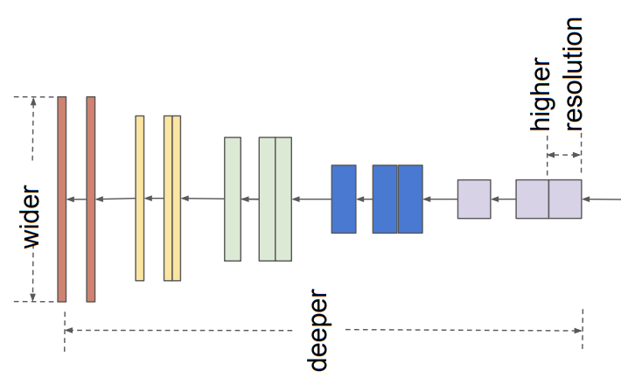
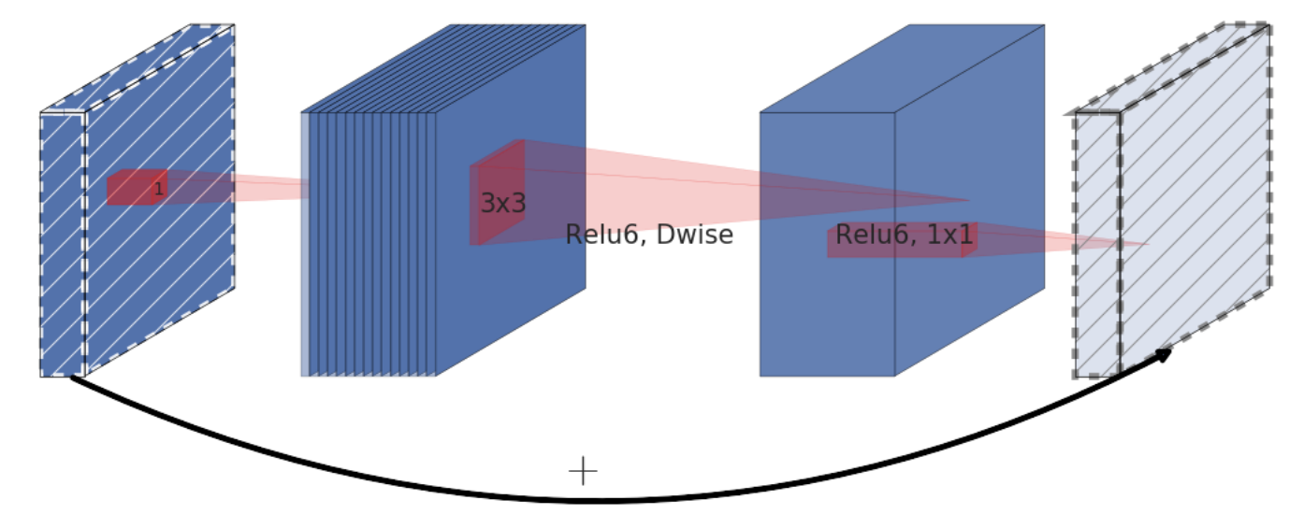
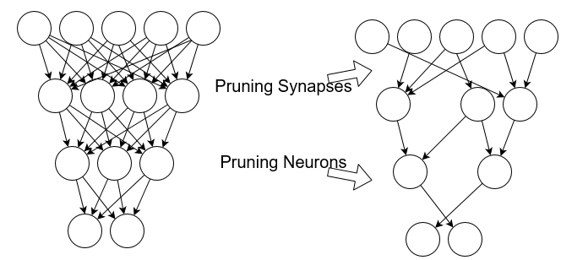
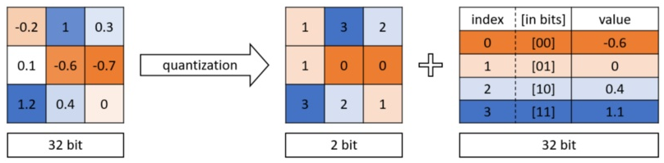
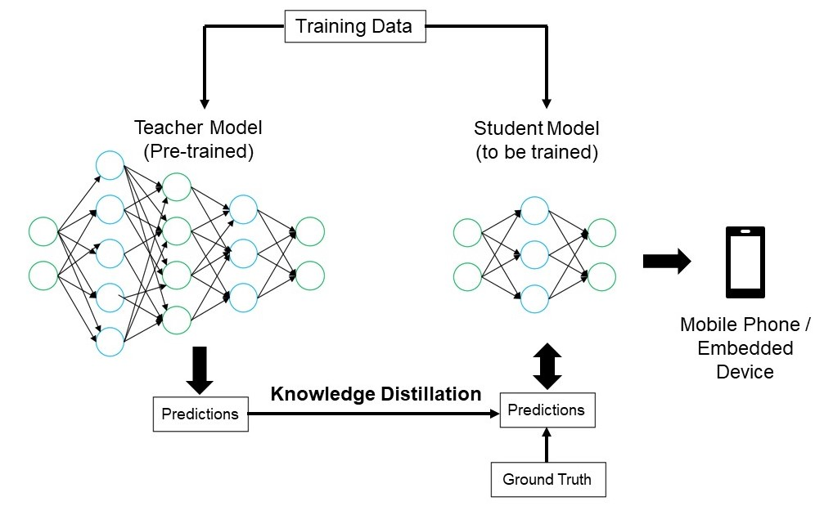
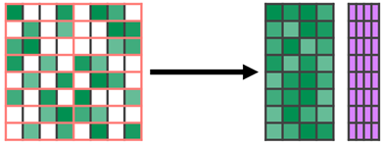
Solutions to Obtain Compact Models
Efficient Architecture
MobileNet
EfficientNet
Model Pruning
Pruning
Quantization
Effective Training Method (e.g., Distillation)
Teacher
Model
Knowledge
Distillation
Student
Model
Sparse Convolution & Low Rank Approximation
6

Slide 7







Popular Platforms for Model Compression
Company
Platform or Toolkit
7

Slide 8
Outline
Compact Model
(Redundancy Reduction)
General Goal:
Reduce Redundancy in Architectures
Reduce Redundancy in
Model Parameters
Key Challenges:
Architecture Optimization
Model Pruning
Neural Architecture Transformer
Solutions:
NeurIPS’19
TPAMI’21
CVPR’19
TPAMI (under review)
Deployment & Applications:
AutoML Platform for
Medical Diagnosis & Game AI
Real-time
Video Conferencing System
8

Slide 9
NAT: Neural Architecture Transformer for Accurate and Compact Architectures
NeurIPS’19 & TPAMI’21
Yong Guo, Yin Zheng, Mingkui Tan, Qi Chen,
Jian Chen, Peilin Zhao, Junzhou Huang
9

Slide 10
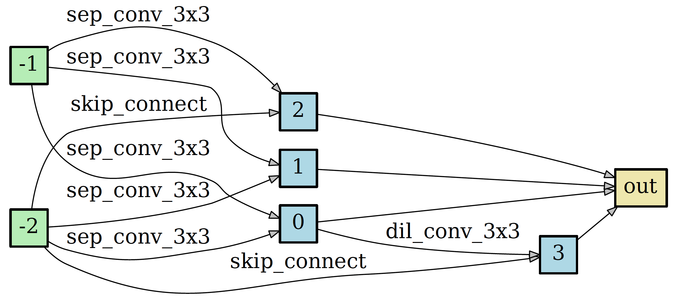
Motivation
Deep models may contain many non-significant modules or operations, which may incur expensive computational cost and deteriorate the performance.
1x1 conv, Relu 6
3x3 dwise, Relu 6
1x1 conv, Linear
Fig. MobileNetV2 block [1].
Fig. DARTS normal cell [2].
How to optimize the redundant operations to improve the architecture design?
[1] Sandler, Mark, et al. "Mobilenetv2: Inverted residuals and linear bottlenecks." Proceedings of the IEEE conference on computer vision and pattern recognition. 2018.
[2] Liu, Hanxiao, Karen Simonyan, and Yiming Yang. "Darts: Differentiable architecture search." International Conference on Learning Representations. 2018.
10

Slide 11
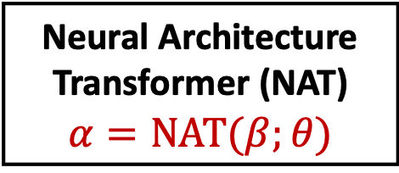
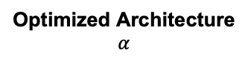
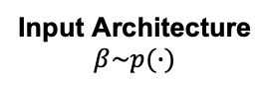
Architecture Optimization
Neural Architecture
Transformer (NAT)
$$α=NAT(β;θ)$$
Input Architecture
$$β\sim p(∙)$$
Optimized Architecture
$$α$$
Fig. Architecture optimization pipeline of NAT.
Optimized Architecture
Better Performance
Lower Computational Cost
Fig. Definition of the optimized architectures.
Can we improve the performance without introducing extra computational cost?
11

Slide 12
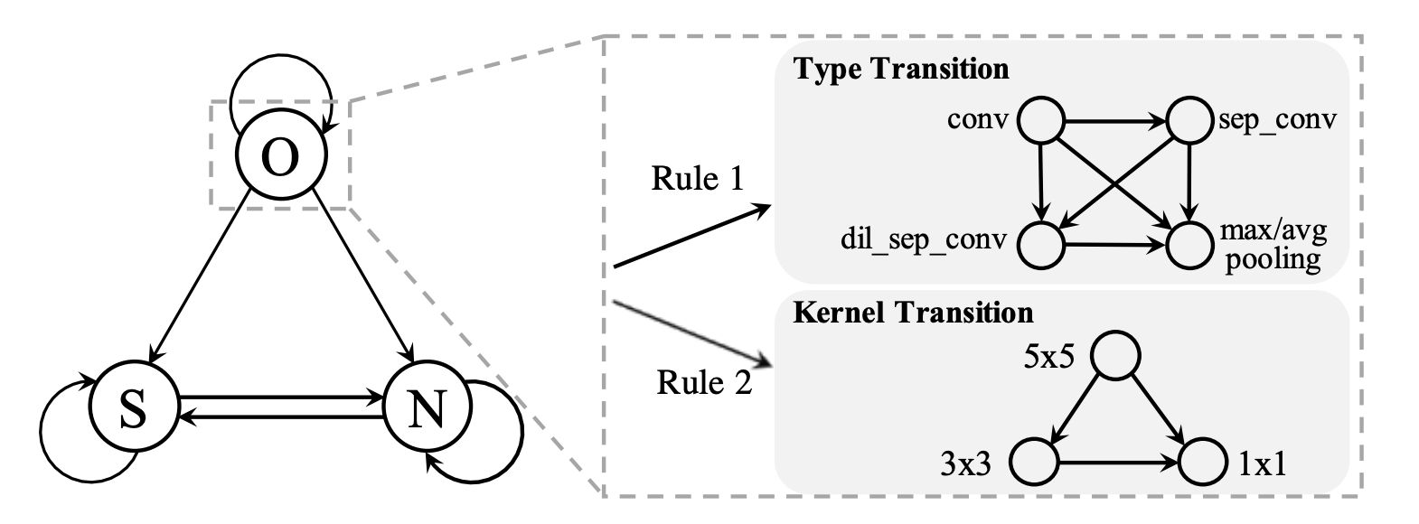
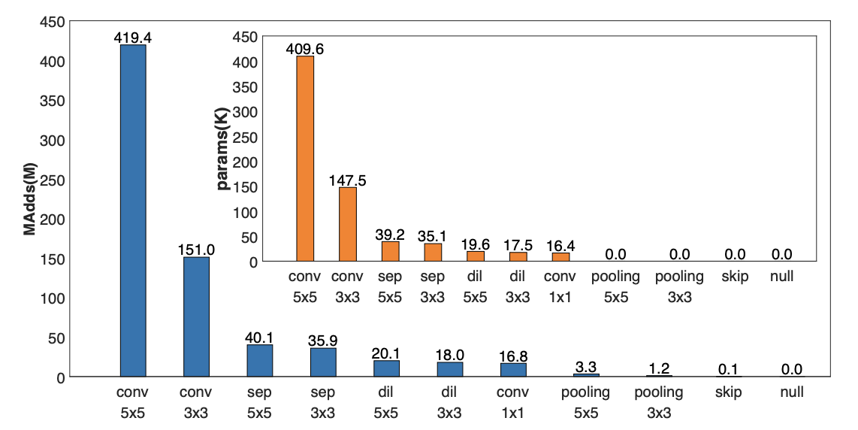
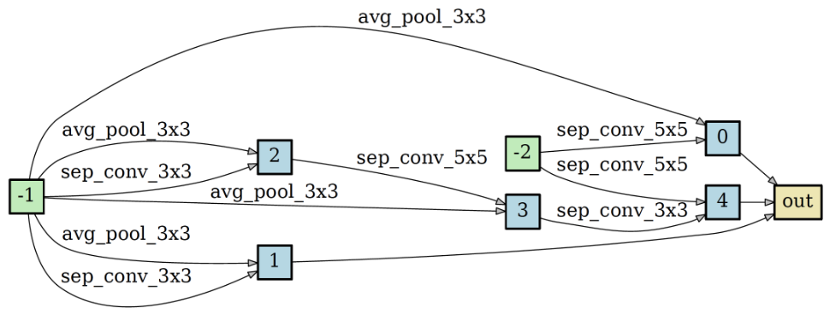
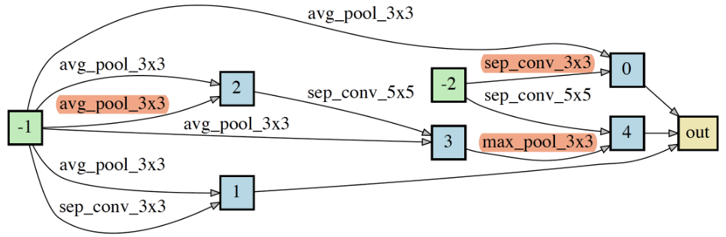
Operation Transition Scheme
We replace the redundant operations with the more efficient ones. S denotes skip connection, N denotes null connection, O denotes the other operations. We have c(O)>c(S)>c(N).
Fig. Operation transition scheme.
Fig. Computational cost of operations.
NAT
12

Slide 13
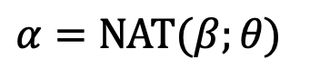
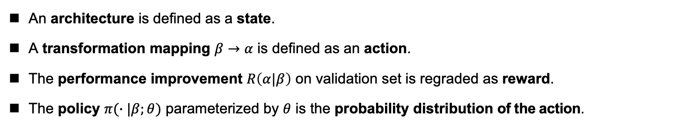
Training Objective for Architecture Optimization
title
Architecture Optimization:
$$α=NAT(β;θ)$$
An architecture is defined as a state.
A transformation mapping $β→α$ is defined as an action.
The performance improvement $R\left(α|β\right)$ on validation set is regraded as reward.
The policy $π(∙|β;θ)$ parameterized by $θ$ is the probability distribution of the action.
Training Objective:
Different input architectures
Conduct sampling according to the policy
Achieved by the operation transition scheme
13

Slide 14
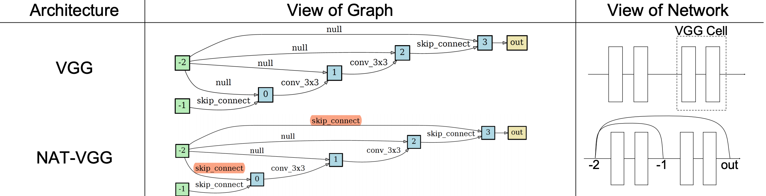
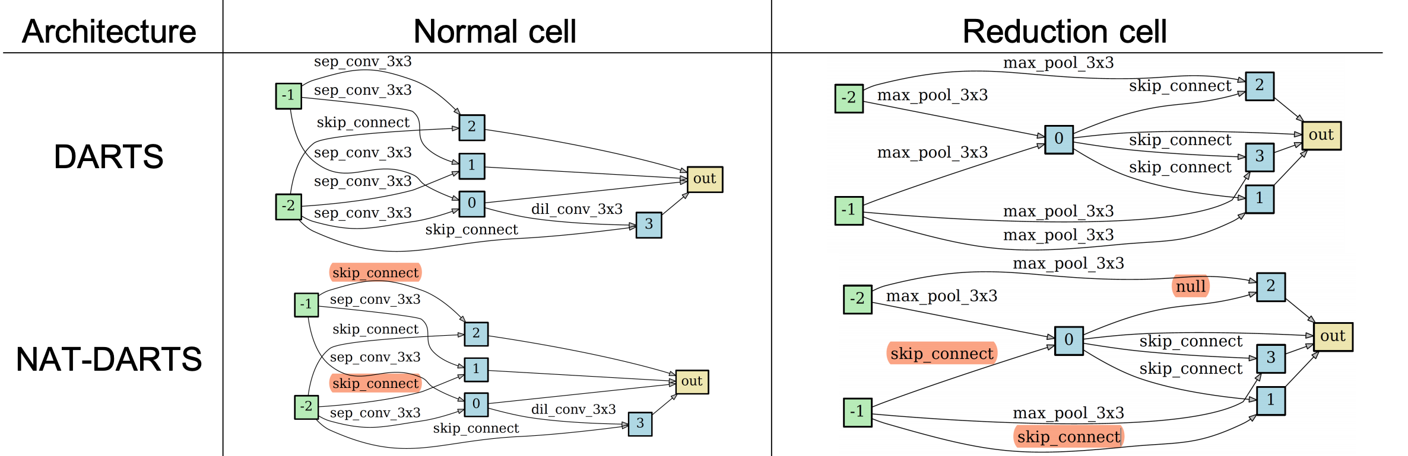
Architecture Optimization Results
title
For hand-crafted architectures
For automatically searched architectures
14

Slide 15
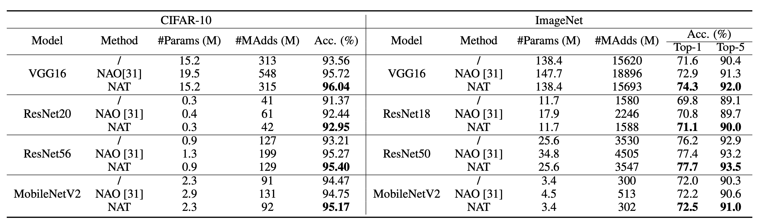
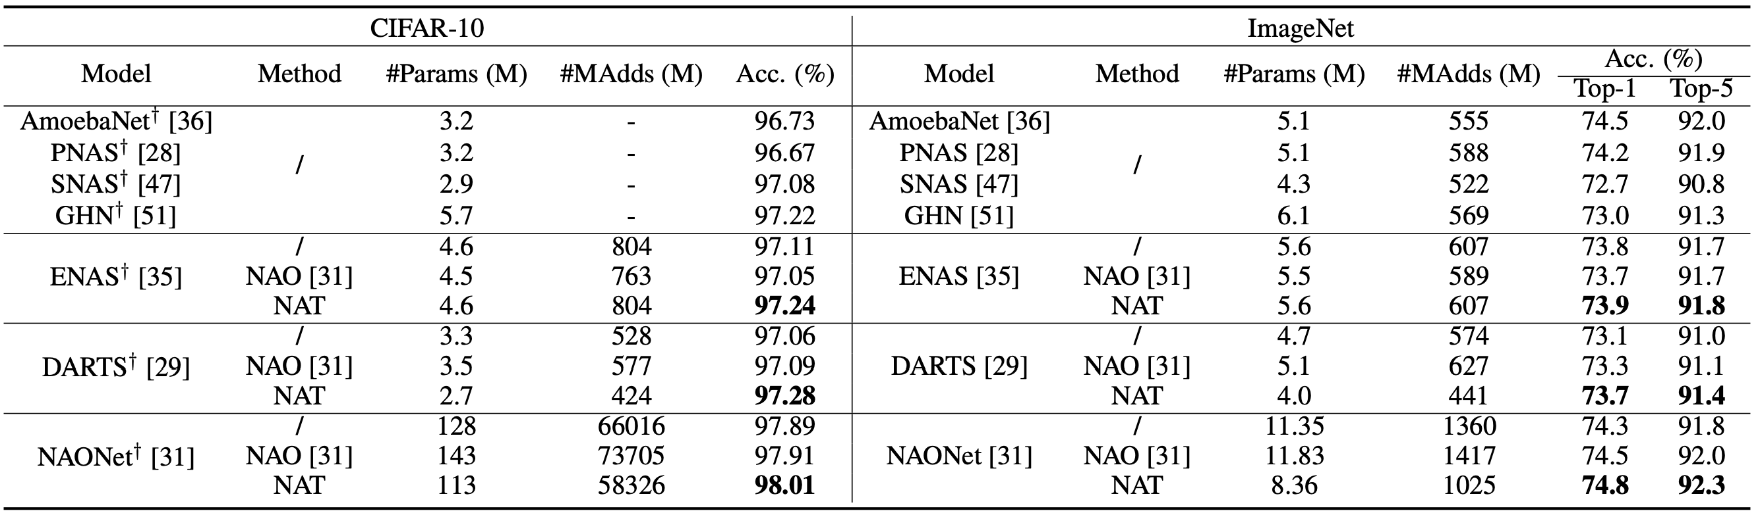
Better Performance and/or Lower Computational Cost
For hand-crafted architectures
For automatically searched architectures
15

Slide 16
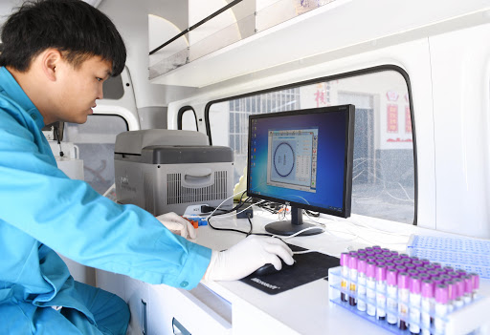
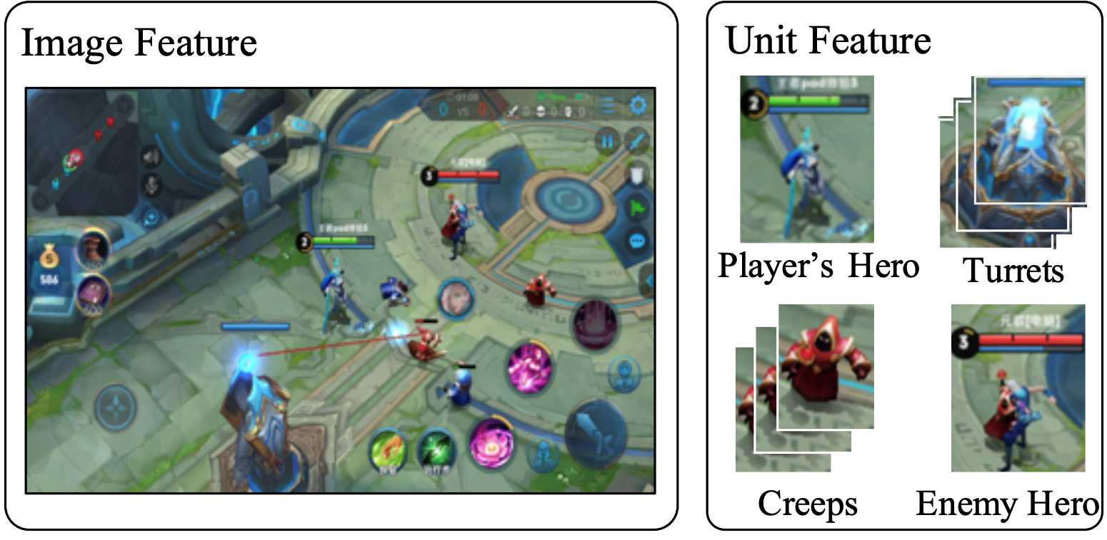
Deployment in Real World
title
Tencent AutoML Platform
Data Preprocessing
Architecture Design
Model Training
Model Evaluation
AutoML
Medical Diagnosis
Game AI (Honor of Kings)
16

Slide 17
Closed-loop Matters: Dual Regression Networks for Single Image Super-Resolution
CVPR’20 & TPAMI (under review)
Yong Guo, Jian Chen, Jingdong Wang, Qi Chen, Jiezhang Cao, Zeshuai Deng, Yanwu Xu, Mingkui Tan
17

Slide 18
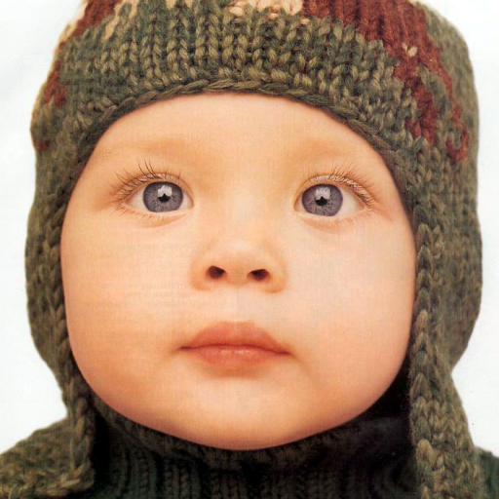

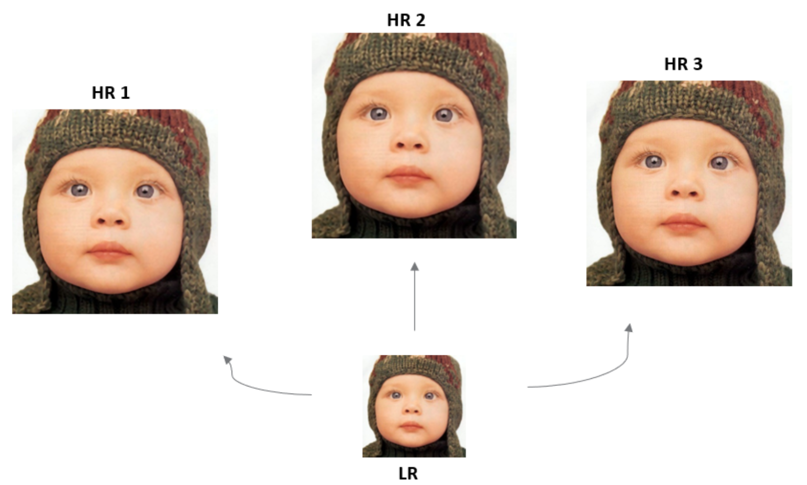
Background
Image Super-Resolution (SR)
LR
HR
SR is a typical ill-posed problem and hard to learn the optimal mapping from LR to HR
Key Challenge: The space of the possible functions that map LR to HR images is extremely large because many different HR images can be downsampled to the same LR image.
18

Slide 19
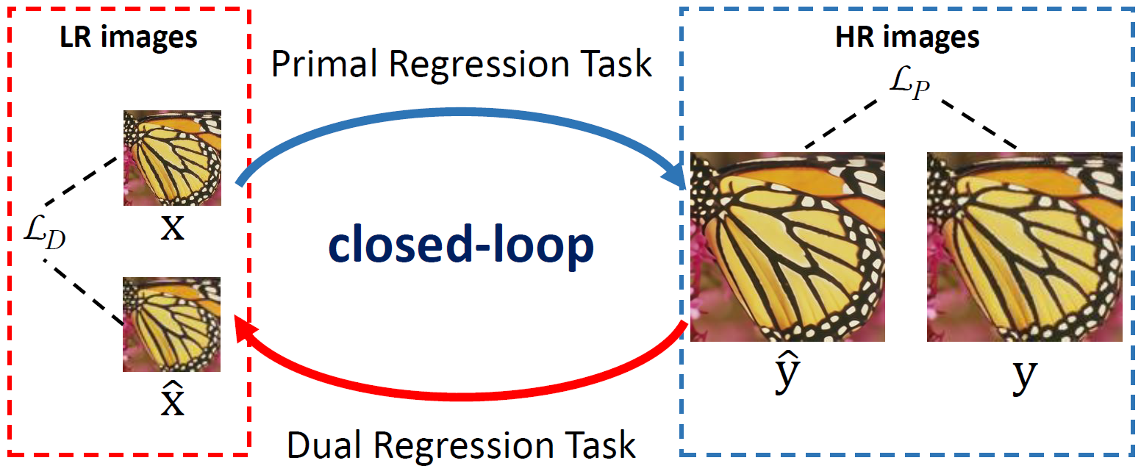
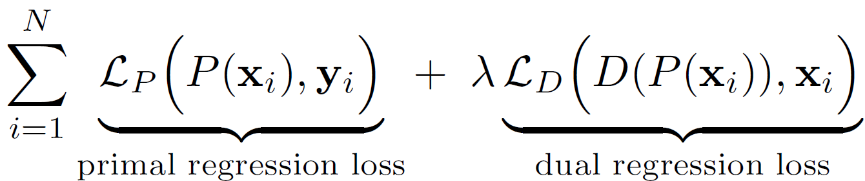
Dual Regression Learning
To reduce the possible function space, we propose a novel dual regression scheme by introducing additional constraints on the learned mapping.
Primal regression task: a mapping from LR to HR images
Dual regression task: an inverse mapping from HR to LR images
Given paired data, we introduce an additional constraint that encourages the reconstructed HR images can be downscaled to their original LR images:
19

Slide 20
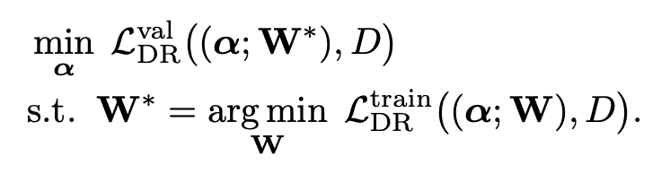
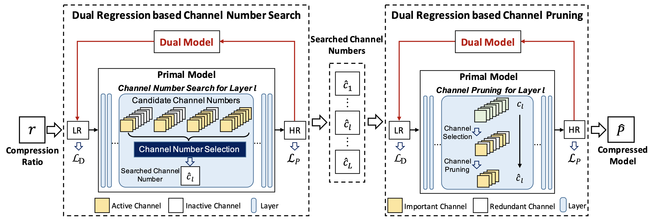
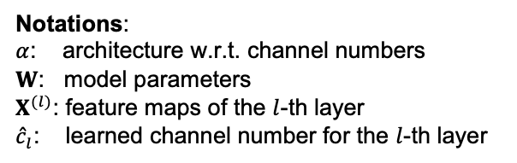
Dual Regression Model Compression
Dual Regression based Channel Number Search
Notations:
$α$: architecture w.r.t. channel numbers
$W$: model parameters
$X^{(l)}$: feature maps of the $l$-th layer
${\hat{c}}_{l}$: learned channel number for the $l$-th layer
Dual Regression based Channel Pruning
20

Slide 21

Trade-off between Performance and Latency
Our DRN models yield a good trade-off between performance and inference latency.
Fig. PSNR vs. latency for 4x SR
Fig. PSNR vs. latency for 8x SR
21

Slide 22



Deployment in Real World
Real-time Video Conferencing System
Key Challenges:
The target processor is much weaker than GPU.
Image resolution is very large and the inference speed of SR models cannot satisfy the real-time requirement.
Compression
Downsampling
(Bicubic)
Display Device
22

Slide 23




面向挑战课题的分析与思路
关键挑战
高分辨率的图片或视频（计算开销大）
图片或视频处理需满足实时性要求
数据
高质量（无损压缩）
实时性（低延时）
鲁棒性（多场景泛化能力强）
图片或视频
硬件
Camera
计算资源受限（算力+内存）
处理器/芯片
研究基础
模型压缩方面有扎实的相关研究工作（论文+专利）
有实际应用中模型部署的经验
解决思路
根据业务需求设计高效的网络结构（手动设计+自动搜索）
根据目标计算开销设计模型压缩策略（剪枝、量化）
针对目标硬件的特性的设计实际模型部署方案
23

Slide 24
未来工作展望
工作展望
业务交付：根据业务需求有针对性地完成模型的设计、训练及部署
个人发展：锻炼多线程工作处理能力，在保证业务完成前提下良性反哺研究，力求实际有产出、学术有影响
团队合作：积极主动融入团队，协同提升个人组织领导能力
未来研究方向
多种不同压缩方法的混合优化，例如寻找剪枝（通道数）和量化（比特数）的最优搭配方案
针对特定模型结构和数据特性的模型压缩方法，例如在Transformer模型中考虑高分辨率图像的输入
算法与硬件的Co-design：包括适配硬件的算法、适配算法的硬件
24

Slide 25
Publications
[1] Yong Guo, Yin Zheng, Mingkui Tan, Qi Chen, Jian Chen, Peilin Zhao, Junzhou Huang. NAT: Neural Architecture Transformer for Accurate and Compact Architectures[A]. In: Advances in Neural Information Processing Systems[C], NeurIPS 2019. 737–748. CCF-A类会议
[2] Yong Guo, Yin Zheng, Mingkui Tan, Qi Chen, Zhipeng Li, Jian Chen, Peilin Zhao, Junzhou Huang. Towards Accurate and Compact Architectures via Neural Architecture Transformer[J]. IEEE Transactions on Pattern Analysis and Machine Intelligence (TPAMI), 2021. JCR一区期刊
[3] Yong Guo, Jian Chen, Jingdong Wang, Qi Chen, Jiezhang Cao, Zeshuai Deng, Yanwu Xu, Mingkui Tan. Closed-loop Matters: Dual Regression Networks for Single Image Super-Resolution[A]. In: Proceedings of the IEEE/CVF Conference on Computer Vision and Pattern Recognition[C], CVPR 2020. 5407–5416. CCF-A类会议
[4] Yong Guo, Yaofo Chen, Yin Zheng, Peilin Zhao, Jian Chen, Junzhou Huang, Mingkui Tan. Breaking the Curse of Space Explosion: Towards Efficient NAS with Curriculum Search[A]. In: International Conference on Machine Learning[C], ICML 2020. 3822–3831. CCF-A类会议
[5] Yong Guo, David Stutz, Bernt Schiele. Improving Robustness by Enhancing Weak Subnets[A]. In: European Conference on Computer Vision (ECCV), 2022. CCF-B类会议
[6] Yong Guo, Qingyao Wu, Chaorui Deng, Jian Chen, Mingkui Tan. Double Forward Propagation for Memorized Batch Normalization[A]. In: AAAI Conference on Artificial Intelligence[C], AAAI 2018. 3134–3141. CCF-A类会议
[7] Yong Guo, Qi Chen, Jian Chen, Qingyao Wu, Qinfeng Shi, Mingkui Tan. Auto-Embedding Generative Adversarial Networks for High Resolution Image Synthesis[J]. IEEE Transactions on Multimedia (TMM), 2019. JCR一区期刊
[8] Yong Guo, Jian Chen, Qing Du, Anton Van Den Hengel, Qinfeng Shi, Mingkui Tan. Multi-way Backpropagation for Training Compact Deep Neural Networks[J]. Neural Networks, 2020. JCR一区期刊
[9] Yong Guo, Yaofo Chen, Mingkui Tan, Kui Jia, Jian Chen, Jingdong Wang. Content-aware Convolutional Neural Networks[J]. Neural Networks, 2021. JCR一区期刊
[10] Yong Guo, Yongsheng Luo, Zhenhao He, Jin Huang, Jian Chen. Hierarchical Neural Architecture Search for Single Image Super-Resolution[J]. IEEE Signal Processing Letters, 2020, 27:1255–1259. JCR二区期刊
[11] Haolin Pan, Yong Guo (共同一作), Qinyi Deng, Haomin Yang, Jian Chen, Yiqun Chen. Improving Fine-tuning of Self-supervised Models with Contrastive Initialization[J]. Neural Networks, 2022. JCR一区期刊
25

Slide 26
Publications
[12] Yaofo Chen, Yong Guo (共同一作), Qi Chen, Minli Li, Yaowei Wang, Wei Zeng, Mingkui Tan. Contrastive Neural Architecture Search with Neural Architecture Comparators[A]. In: Proceedings of the IEEE/CVF Conference on Computer Vision and Pattern Recognition[C], CVPR 2021. CCF-A类会议
[13] Jiezhang Cao, Yong Guo (共同一作) , Qingyao Wu, Chunhua Shen, Junzhou Huang, Mingkui Tan. Adversarial Learning with Local Coordinate Coding[A]. In: International Conference on Machine Learning[C], ICML 2018. 706–714. CCF-A类会议
[14] Jiezhang Cao, Yong Guo (共同一作),, Qingyao Wu, Chunhua Shen, Junzhou Huang, Mingkui Tan. Improving Generative Adversarial Networks with Local Coordinate Coding[J]. IEEE Transactions on Pattern Analysis and Machine Intelligence (TPAMI), 2020. CCF-A类会议
[15] Yixin Liu, Yong Guo (共同一作), Zichang Liu, Haohua Liu, Jingjie Zhang, Zejun Chen, Jing Liu, Jian Chen. Conditional Automated Channel Pruning for Deep Neural Networks[J]. IEEE Signal Processing Letters, 2021. JCR二区期刊
[16] Lizhao Liu, Junyi Cao, Minqian Liu, Yong Guo (共同一作), , Qi Chen, Mingkui Tan. Dynamic Extension Nets for Few-shot Semantic Segmentation[A]. In: Proceedings of the 28th ACM International Conference on Multimedia[C], ACMMM 2020. 1441–1449. CCF-A类会议
[17] Shuaicheng Niu, Jiaxiang Wu, Guanghui Xu, Yifan Zhang, Yong Guo, Peilin Zhao, Peng Wang, Mingkui Tan. AdaXpert: Adapting Neural Architecture for Growing Data[C], In: International Conference on Machine Learning (ICML), 2021. CCF-A类会议
[18] Jing Liu, Bohan Zhuang, Zhuangwei Zhuang, Yong Guo, Junzhou Huang, Jinhui Zhu, Mingkui Tan. Discrimination-aware Network Pruning for Deep Model Compression[J], IEEE Transactions on Pattern Analysis and Machine Intelligence (TPAMI), 2021. JCR一区期刊
[19] Zhuangwei Zhuang, Mingkui Tan, Bohan Zhuang, Jing Liu, Yong Guo, Qingyao Wu, Junzhou Huang, Jinhui Zhu. Discrimination-aware Channel Pruning for Deep Neural Networks[J], In: Advances in Neural Information Processing Systems (NeurIPS), 2018. CCF-A类会议
[20] Shuaicheng Niu, Jiaxiang Wu, Yifan Zhang, Yong Guo, Peilin Zhao, Junzhou Huang, Mingkui Tan. Disturbance-immune Weight Sharing for Neural Architecture Search[J], Neural Networks, 2021. JCR一区期刊
[21] Zhuoman Liu, Wei Jia, Ming Yang, Peiyao Luo, Yong Guo, Mingkui Tan. Deep View Synthesis via Self-Consistent Generative Network[J], IEEE Transactions on Multimedia (TMM), 2020. JCR一区期刊
[22] Chao Han, Yunkun Tan, Jinhui Zhu, Yong Guo, Jian Chen, Qingyao Wu. Online Feature Selection of Class Imbalance via PA Algorithm[J], Journal of Computer Science and Technology (JCST), 2016. JCR二区期刊
26

Slide 27
Patents
[1] 神经网络模型的压缩方法和装置, CN2019102484613. 国雍、郑胤、赵沛霖、黄俊洲
[2] 网络结构搜索方法、装置、设备及计算机可读存储介质, CN2020110841244. 国雍、郑胤、赵沛霖、黄俊洲
[3] 模型生成方法、装置及服务器, CN2019103129892. 郑胤、陈晓爽、国雍、赵沛霖、黄俊洲
[4] 神经网络的网络结构优化器的训练方法、装置、电子设备及存储介质, CN110782015A. 郑胤、国雍、魏秉政、黄汉煜、黄彦、王骕、路彦雄、林乐宇
[5] 一种基于双前向传播算法的记忆归一化网络层方法, CN2019108258599. 谭明奎、吴庆耀、国雍
27

Slide 28
Thanks for your attention!
Q&A
28

